Slide 1
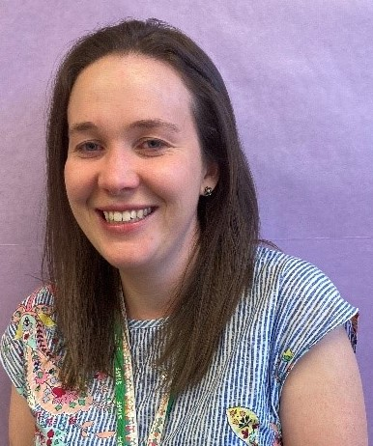
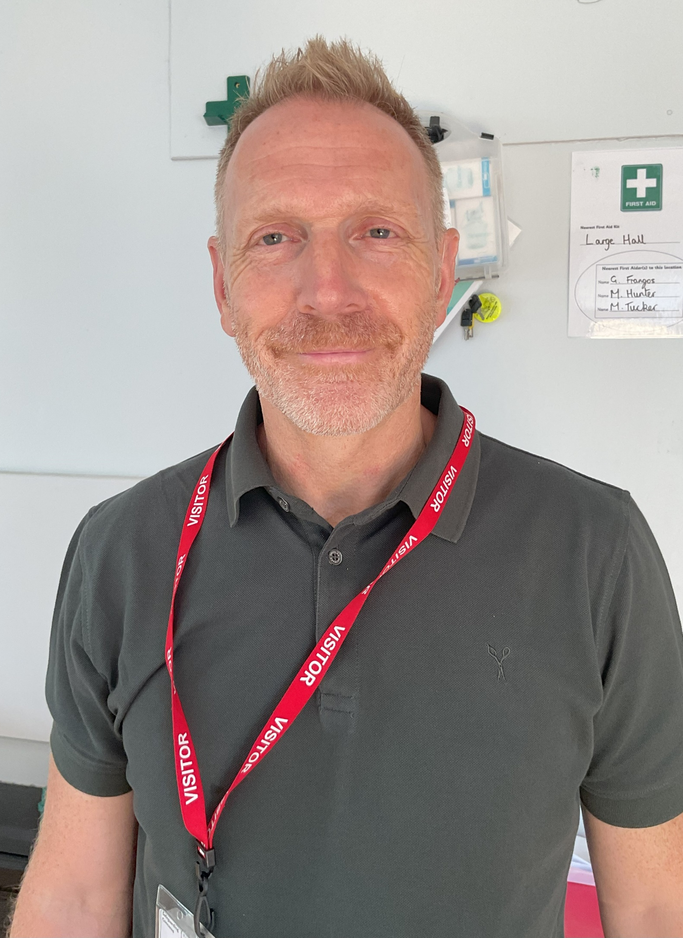
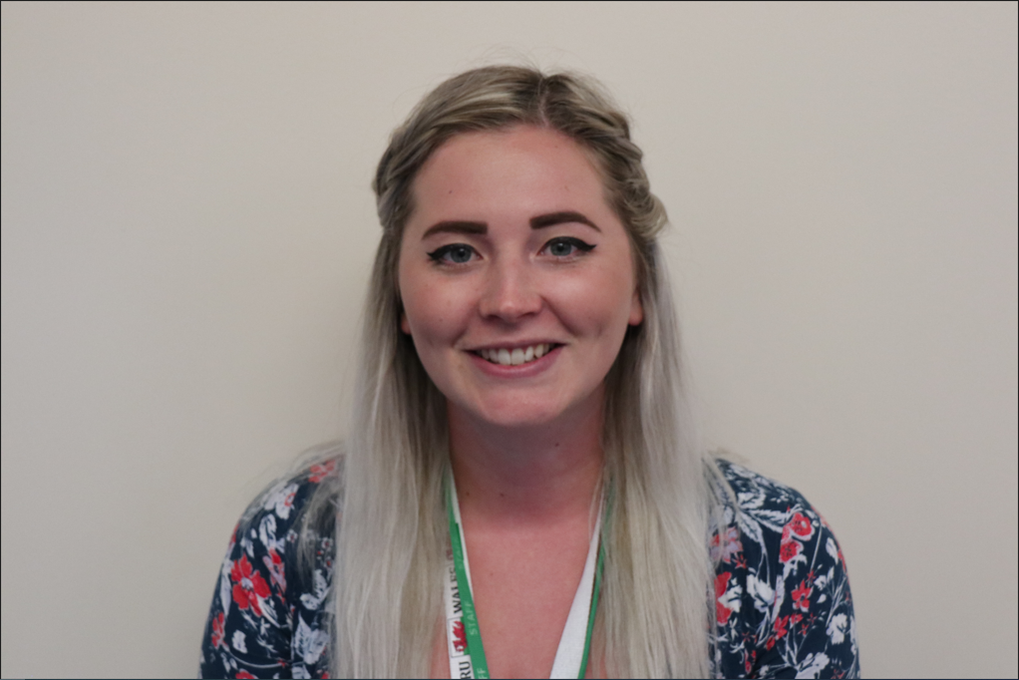
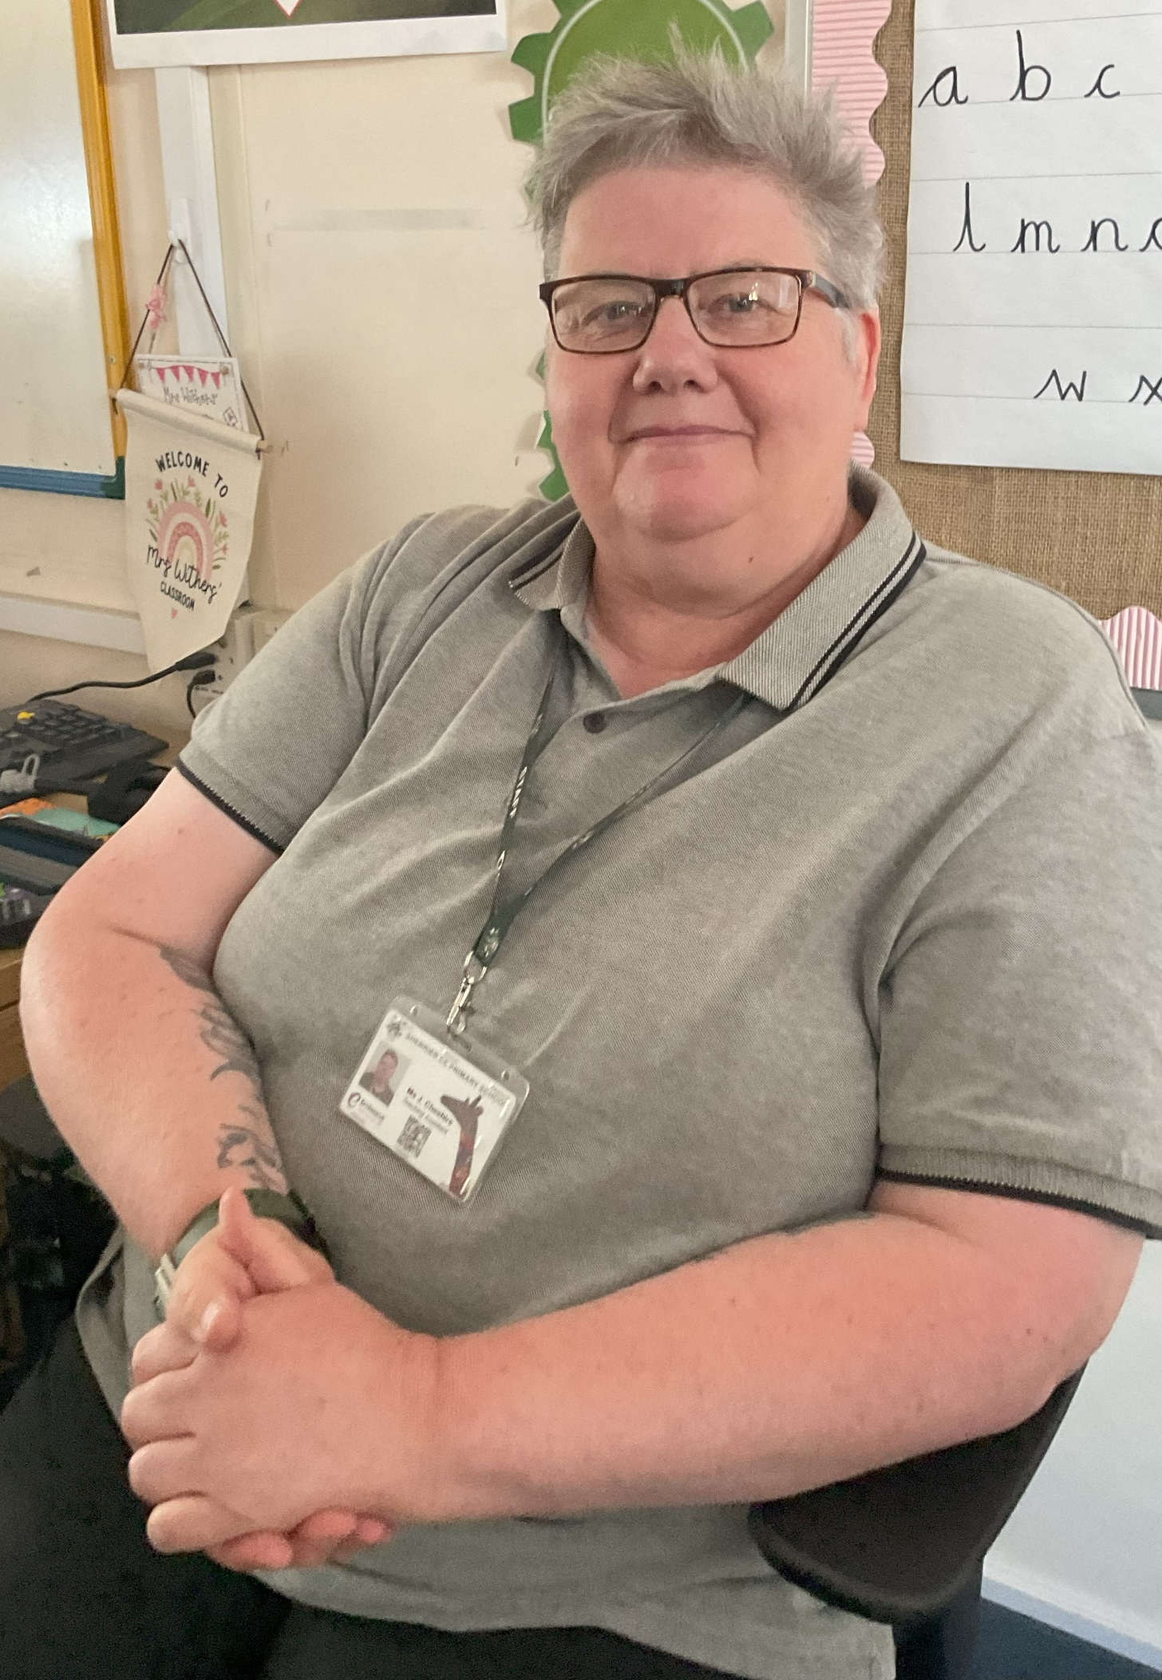
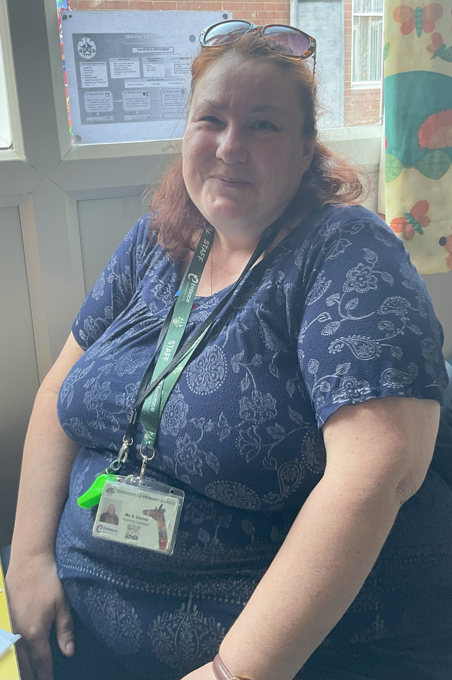
Welcome to Year 3
Miss Thomas
Mrs Perman
Mr Dufty
Miss Davies
Ms Cheshire

Slide 2

School Values/Learning behaviours
Each of our year groups are ambassadors for our chosen Christian values:
Friendship – EYFS Generosity –Y1 Courage Y2 Thankfulness –Y3 Trust – Y4 Forgiveness -Y5 Justice –Y6
We teach skills that are needed to learn well -Keys To Success
Whole School
Resilience
Persistence
Organisation
Getting Along
Confidence
PLUS WE HAVE R2R CHARACTER MUSCLES:
EYFS- Independence
Y1 – Concentration
Y2- Making connections and asking Questions
Y3- Curiosity
Y4-Managing Impulsivity
Y5-Self-esteem
Y6-Self-efficacy

Slide 3
Welcome to Year 3
We are thrilled to welcome you all to the start of Year 3!
Now that your child is in Key Stage 2 (KS2), we kindly ask that you provide your child with a healthy snack to enjoy during break time, as these are no longer provided, like in KS1. Each classroom will have a designated box where snacks can be stored until break time.
In addition to a snack, please ensure that your child brings a water bottle to school each day. Having a water bottle on hand will help your child remain hydrated and focused throughout the day.
Thank you for your support and cooperation. Together, we’ll make this a fantastic year for your children!

Slide 4
Year Group Organisation
Our PE Days will be Mondays and alternate Thursdays. Children will need to wear suitable PE kit to school on these days. (Long hair tied back/ Earrings removed or covered with tape).
Forest School will be on alternate Wednesdays. Children will need to wear their PE kit/outdoor clothing for any weather for this. They will have puddle suits to put over their clothes. Please make sure that your child has a pair of wellies in school – we have racks outside the classroom for these to be safely stored. If your child has had a Forest School they will not have PE on a Thursday.
Dropping off / Picking up
Year 3 will enter and exit their classroom through the classroom/cloakroom doors which open on to the Large Playground.
Children will be released from the same door that they enter through. Even though 3TP are sharing a cloakroom with Year 6, they must enter school through the classroom door to ensure adults know who has arrived.

Slide 5
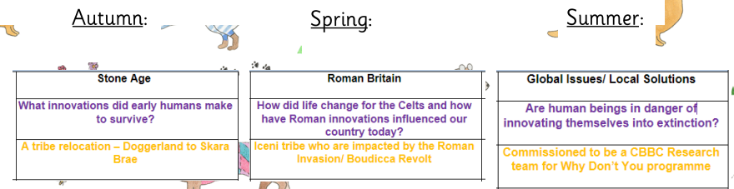
Curriculum Overview
In Year 3, we will study a range of subjects. Most days will include Maths, Writing and VIPERS lessons. Other subjects taught are: History, Geography, Science, Jigsaw (PSHE scheme), RE, Art and Design, PE, Forest School, Music and French.
Through our Mantle of the Expert lens we will also explore the following areas:
These areas of learning will also be explored through other subjects too.
Our key word for Year 3 is Innovation.

Slide 6
Writing for Pleasure
Writing in KS2 is very different to KS1. We will be moving away from book making and instead be making use of Personal Writing Books and Writing for Pleasure exercise books. We will be exploring a range of genres, purposes for writing and consider different audiences for our published work.
In the Autumn Term our writing genres will be:
Poetry and Information Texts.

Slide 7
Reading
At Sherrier, the expectation is that all children will read at home at least three times every week. On each occasion, the parent or child (if they are in Key Stage 2) must:
•Record the date and name of the text
•Note down how much text has been read
•Comment on the reading taking place
•Initial the comment
•Log the running total of reading nights
In school, there will be continuous monitoring of how often each child has read at home and awards (certificates and stickers) will be handed out to those children reaching set milestones. Children will also receive their ‘star’ on the whole class reading chart displayed within each classroom. Please can you ensure that your child has their reading book/ reading log with them in school on a daily basis. Thank you!

Slide 8
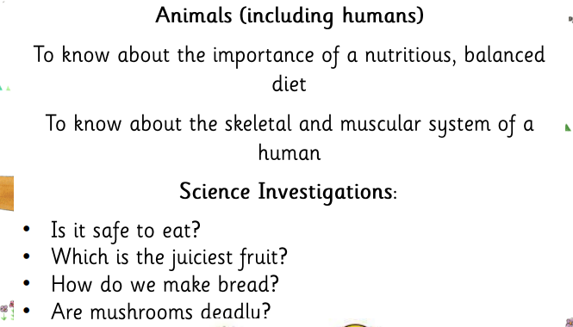
Science

Slide 9
What Innovations Did Early Humans Make To Survive
Throughout the Autumn Term we will explore this question whilst studying the Stone Age. We will use History lessons to develop the children’s understanding of the time period and our Mantle of the Expert lessons to immerse them in what the time period would have been like. We will use different drama conventions and questioning to help them consider the experiences people went through during this historic era.

Slide 10
Homework
In KS2 children are expected to:
Complete their X-Factor sheet each week (this will need to be marked at home).
Read three times a week and complete thie rReading Journal to show this.
Complete their Spelling homework this will be varied and include a range of activities containing: Tier 3 language (topic), Spelling Tests, Spelling Shed Homework (with the rule they have been learning throughout the week).

Slide 11

Class Dojo
Class Dojo has improved the way we communicate and update you on the activities your child is doing in school. It is also used for the following; dates for your diary, sending your child's school reports and dinner menu changes. We will also use it to update you on your child's achievements/behaviour where you will receive a notification on your Dojo App.
Using the message feature:
Class Dojo messages will be received by teachers between the hours of 8.30am - 5pm. You may receive a response for these messages during these hours; however, please do not expect a response immediately as it's not always feasible to reply. If your message is urgent then please contact the school office. Any going home messages need to be communicated with the office incase messages are not seen.

Slide 12

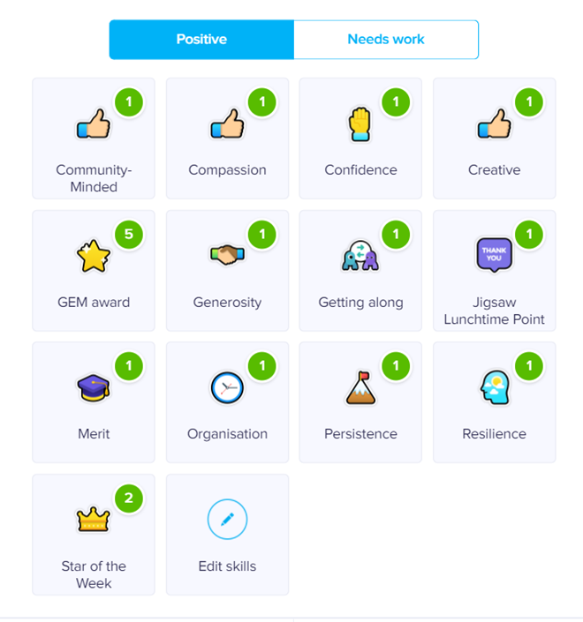

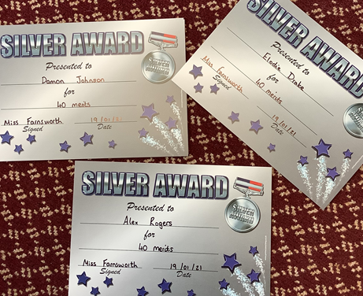
Rewards and Sanctions
Rewards
Merits – given to children for their own learning, recorded on Dojo under merit section. Every 20 gets a certificate.
Team Points- given to children matching the keys to success etc. Recorded on Dojo and goes towards house team points (Mica, Topaz, Emerald, Saphire.
GEM Award- going the extra mile – a special visit to Miss Beckett to get a certificate and a prize!
Star of the Week- every Friday a member of each class will be awarded Star of the Week certificate and receive this in a special assembly.
Jigsaw Lunchtime Award- Given by staff in the form of a Pom Pom goes towards a collected team point system.
Sanctions
Yellow Card- 1 Dojo point to be removed and parents to be informed.
Red Card – more serious incidents. 3 Dojo points to be removed. Parents to be informed.

Slide 13
Getting in touch with us..
Please contact us on Class Dojo if you have a query about anything
Classroom –based staff are with the children during school hours so will be unable to reply between 8.40 and 3.30pm
We love seeing you face to face and will always be happy to talk to you about your child, however please be mindful of the fact that at the beginning of the school day Class Teachers and Support Staff need to be in the classrooms supporting children with their morning tasks. At the end of the day School staff will be focussing on dismissing children safely and therefore may not be able to speak to you.
If your contact is of a more urgent nature during the day please contact the school office and Mrs Lynda Coupland will help you -01455 552791
l.Coupland@sherrier.embracemat.org
If you would like pastoral support for your child please see Mrs Karen Lill outside on the playground or contact the office for her to get in contact with you

